Slide 1
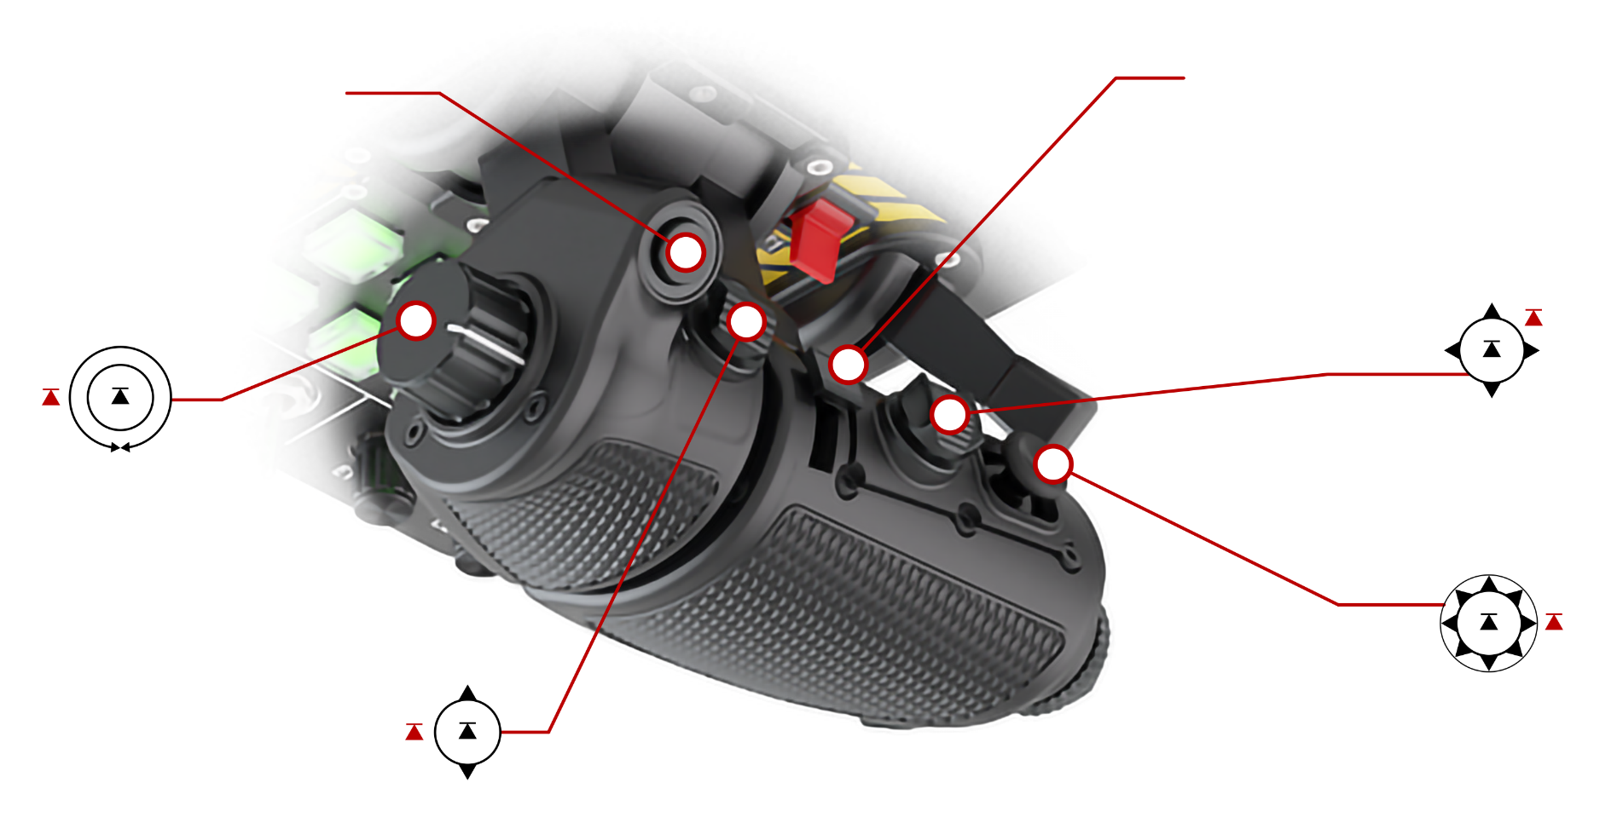
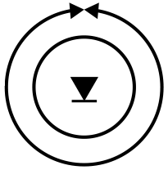



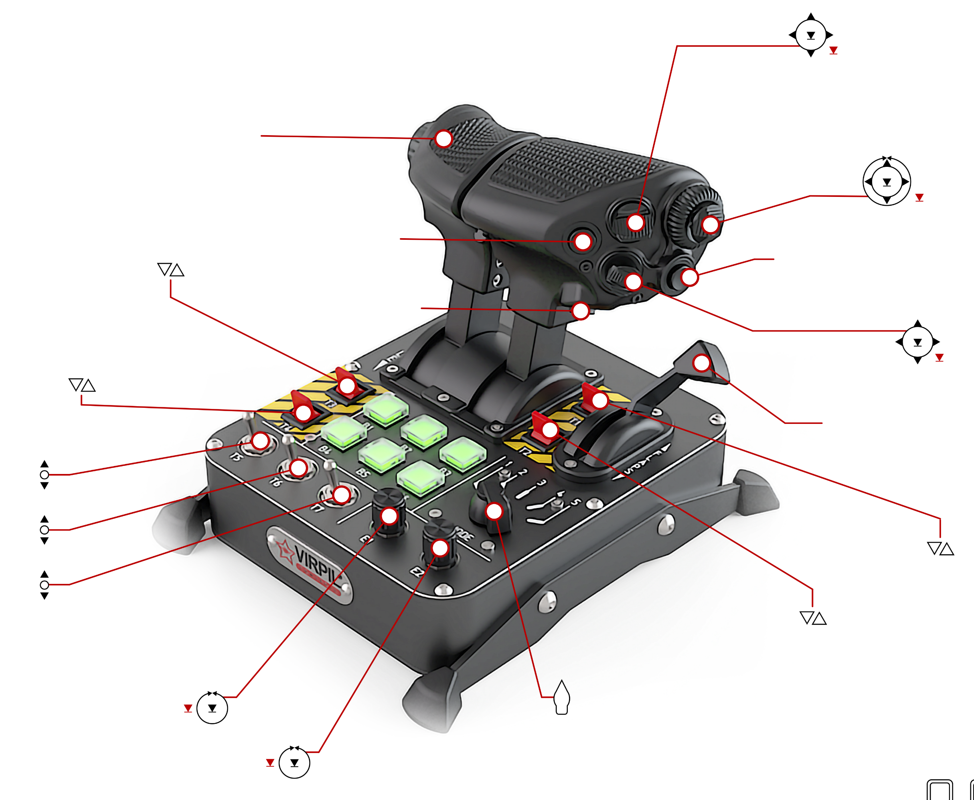





Roll Forward (C-CW) | 3
Roll Backward (CW) | 2
Press In | 1
4
FW/BW Analog (BW = Positive) | Z
L/R Analog | X
U/D Analog | Y
Press In | 13
Back (Up) | 11
FW (Down) | 9
Left | 12
Right | 10
Press In | 8
Right Throttle Forward/ Backward Analog | rY
Back (Up) | 7
Forward (Down) | 6
Press In | 5
Up | 25
Down | 23
Left/Back | 24
Right/ Forward | 26
Press In | 22
Left Throttle Forward/ Backward Analog | rX
T3 (Up = Button Pushed) | 36
T4 (Up = Button Pushed) | 37
Roll Forward | 14
Roll Backward | 15
Up | 20
Down | 18
Left/Back | 19
Right/Forward | 17
Press In | 16
32
T5 – Up | 44
T5 – Down | 45
T6 – Up | 46
T6 – Down | 47
T7 – Up | 48
T7 – Down | 49
33
21
E1 – Counter-Clockwise | 51
E1 – Clockwise | 52
E1 – Press In | 50
Mode Selector Switch
(Pages Through B1-B6 Buttons – See Next Page)
Up | 30
Down | 28
Left/Back | 29
Right/ Forward | 31
Press In | 27
T2 (Up = Button Pushed) | 35
E2 – Counter-Clockwise | 54
E2 – Clockwise | 55
E2 – Press In | 53
T1 (Up = Button Pushed) | 34
Flaps Forward/ Backward Analog | rZ

Slide 2
Mode 1 (Not Lit)
B1 | 38
B2 | 39
B3 | 40
B4 | 41
B5 | 42
B6 | 43
Mode 4 (Red)
B1 | 68
B2 | 69
B3 | 70
B4 | 71
B5 | 72
B6 | 73
Mode 2 (Blue)
B1 | 56
B2 | 57
B3 | 58
B4 | 59
B5 | 60
B6 | 61
Mode 5 (Yellow)
B1 | 74
B2 | 75
B3 | 76
B4 | 77
B5 | 78
B6 | 79
Mode 3 (Green)
B1 | 62
B2 | 63
B3 | 64
B4 | 65
B5 | 66
B6 | 67

